Slide 1


INTELLIGENT STUDENT CODE ANALYSIS PLATFORM
AI-Driven Code Reviewer
Revolutionizing Programming Education with Artificial Intelligence

Slide 2

OUR VISION
The Future of Code Education Starts Here
We are building an AI-powered automated code review system that analyzes student submissions and delivers instant, intelligent, and actionable feedback — at scale. No delays. No inconsistency. Just pure intelligence.

Slide 3




The Problem We Solve
Manual code review is broken. Instructors are overwhelmed, feedback is delayed, and quality is inconsistent. The system does not scale.
1
❌ Not Scalable
2
⏱ Delayed Feedback
3
📉 Inconsistent Evaluation
4
🕒 Time-Consuming Process
Each layer represents a compounding failure in traditional code review — from wasted time at the base to total lack of scalability at the top.

Slide 4



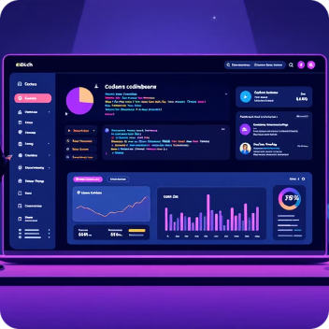
Who We Serve
Our platform is purpose-built for every stakeholder in the programming education ecosystem.
Students
Universities
Instructors
EdTech Platforms
Instant, personalized feedback accelerates learning and builds confidence.
Automate grading pipelines and maintain consistent evaluation standards.
Dramatically reduce manual workload — focus on teaching, not grading.
Embed AI-powered review into any coding platform at unlimited scale.

Slide 5




Our Intelligent Solution
A unified platform that combines AST parsing precision with GPT-level intelligence to deliver real-time, automated, and deeply insightful code reviews.
Instant AI Review
Automated Feedback
Sub-2-second feedback on every submission
Intelligent reports generated without human intervention
Infinite Scale
Deep Intelligence
Supports thousands of concurrent submissions
Semantic, structural, and stylistic analysis in one pass

Slide 6





Key Modules & Deliverables
Error Detection
Identifies syntax, logic, and runtime errors with high precision using AST traversal.
Style Compliance
Enforces PEP8 and industry coding standards automatically on every submission.
Optimization Engine
Surfaces performance bottlenecks and suggests efficiency improvements.
Automated Reports
Generates rich, student-friendly review reports instantly and consistently.
Student Interface
Clean, interactive, and fast UI designed for the modern learner.

Slide 7





System Architecture Pipeline
Every student submission flows through a precisely engineered, multi-layer intelligence pipeline — from raw code to rich, actionable feedback.
Input
Backend
Student code submission
Server routing and jobs
Frontend
Parser
User interface and validation
AST analysis engine
The architecture is modular, horizontally scalable, and designed for zero-latency feedback delivery — even under high concurrency loads.

Slide 8
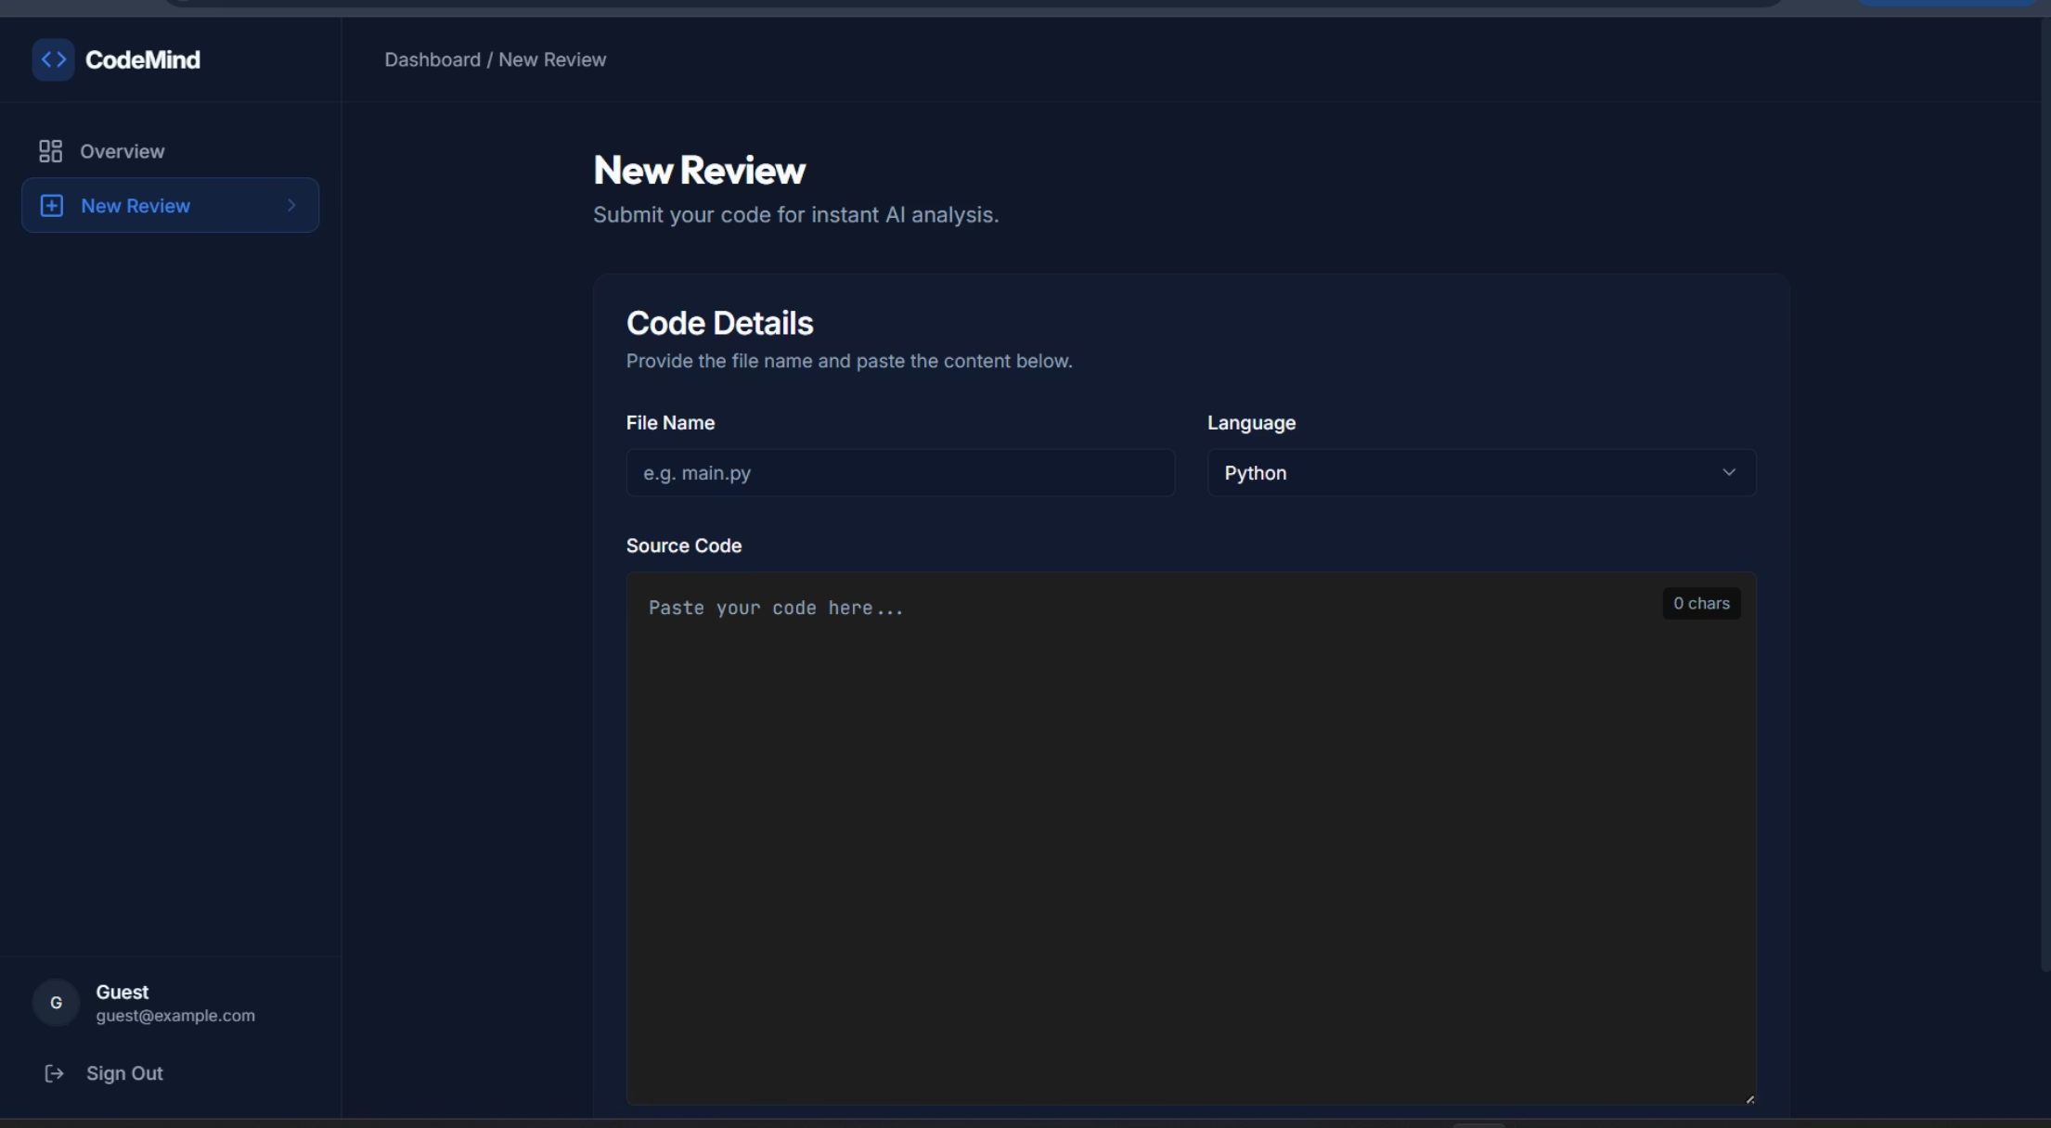
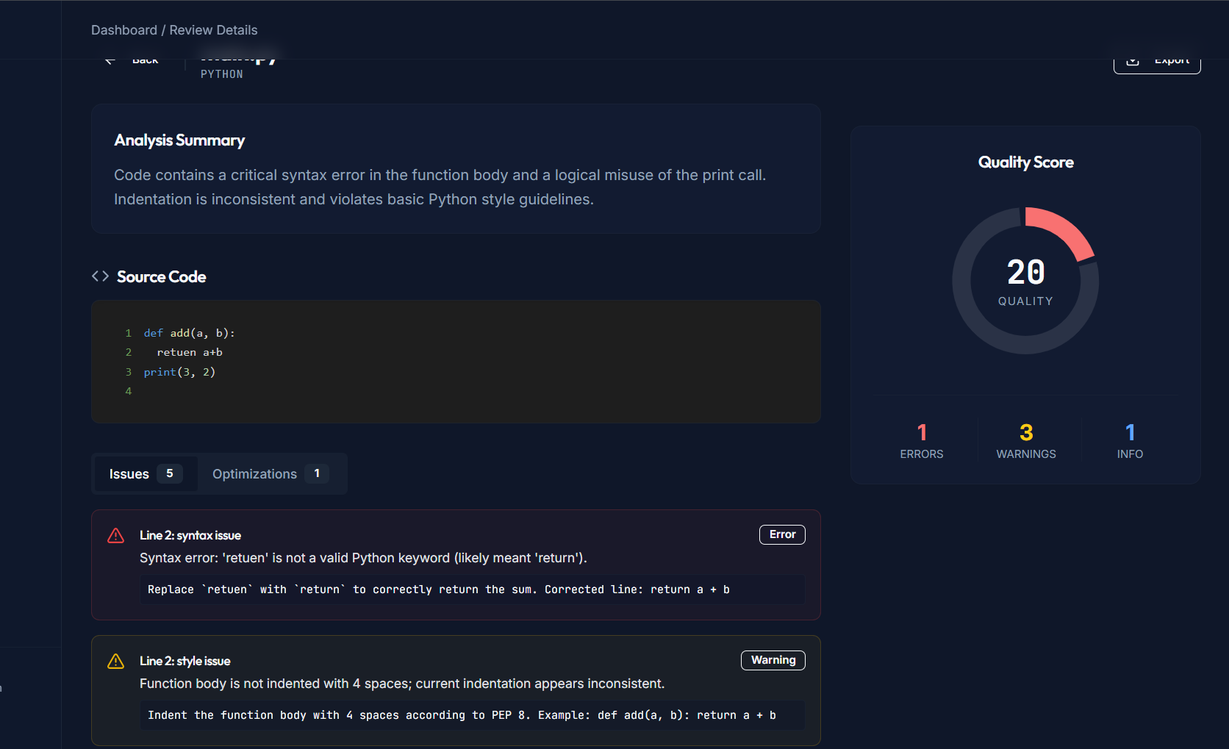
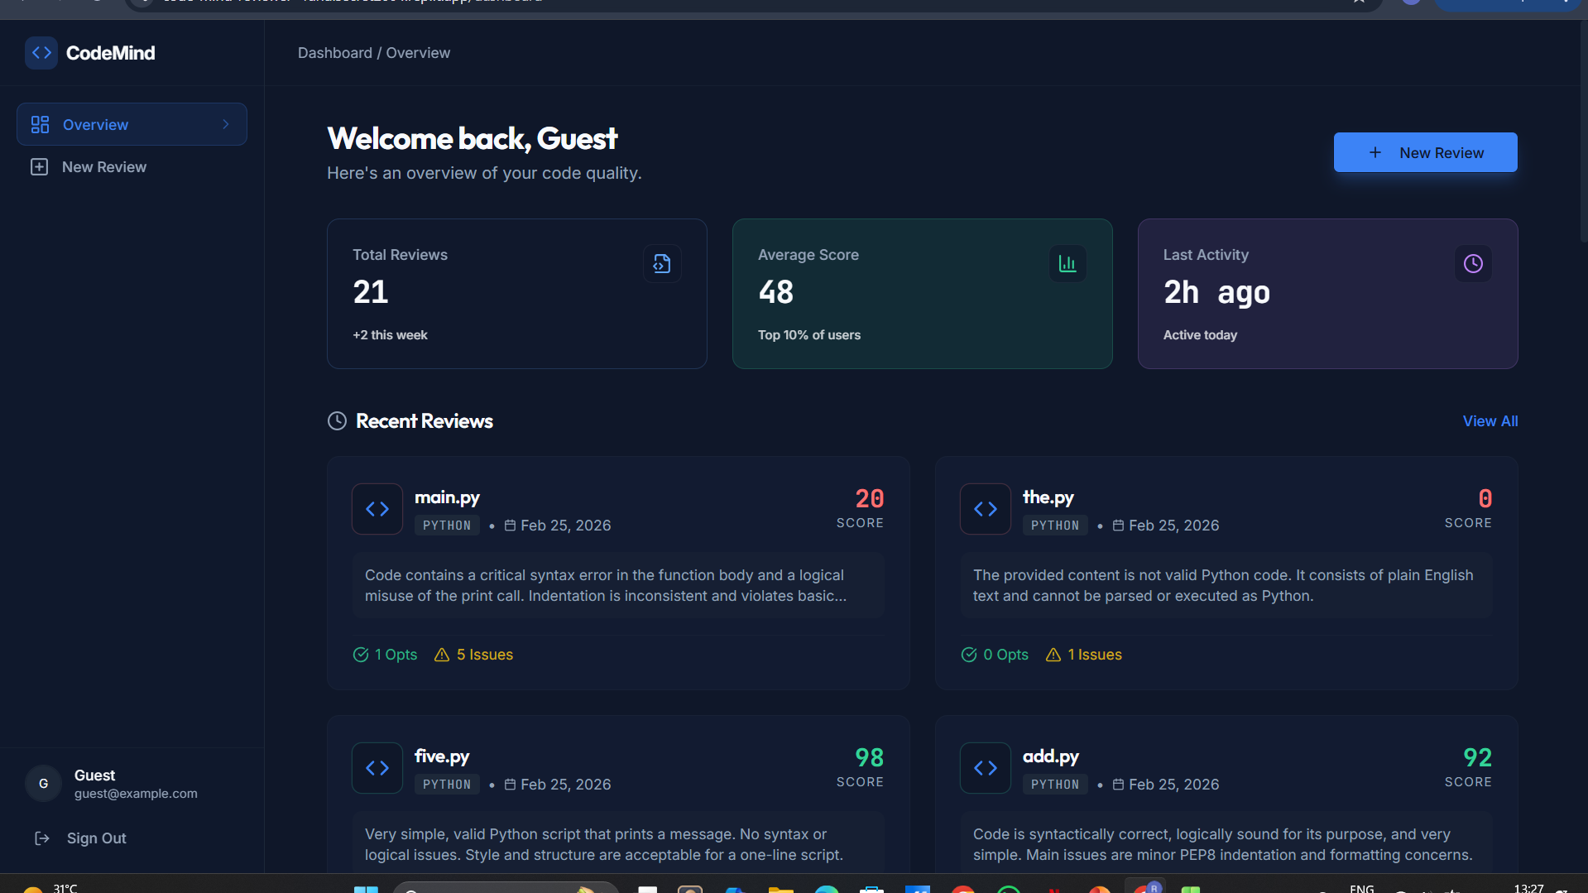
Live Platform Demo & Key Capabilities
Real-time AI-powered code review in action
⚡ Instant Code Analysis
Users submit code and receive feedback instantly
🧠 Intelligent Error Detection
Detects syntax, logic, and style issues automatically
📊 Quality Score & Optimization
Generates code quality score and improved version
📁 Review Dashboard Tracking
Stores review history for continuous improvement

Slide 9
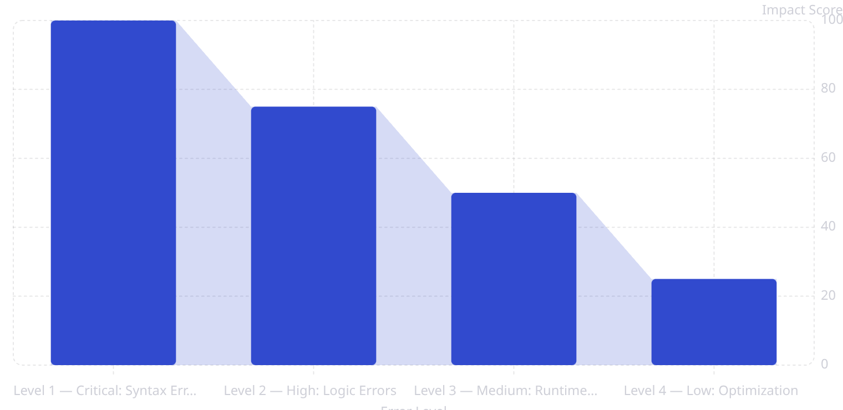
Error Analysis & Detection Levels
25%
Multi-Level Intelligence
Total conversion rate
Our system classifies every issue across four severity tiers, ensuring students receive prioritized, actionable guidance — not just a list of errors.
Critical — Blocks execution entirely
High — Produces wrong outputs
Medium — Causes instability at runtime
Low — Misses performance potential

Slide 10


THE ROAD AHEAD
Vision, Impact & Future Scope
🌍 Multi-Language Support
Expand beyond Python to Java, C++, JavaScript, and more.
🎙 Voice Feedback
Audio-driven explanations for accessibility and deeper learning.
📊 Advanced Analytics
Institution-wide dashboards tracking student progress over time.
🔌 IDE Integrations
Native plugins for VS Code, JetBrains, and GitHub Classroom.
The AI-Driven Code Reviewer is not just a tool — it is the foundation of the next generation of programming education. Built for scale. Designed for impact. Ready for the world.

